Slide 1
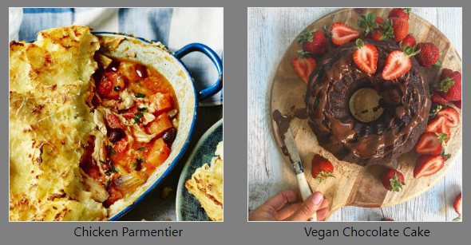
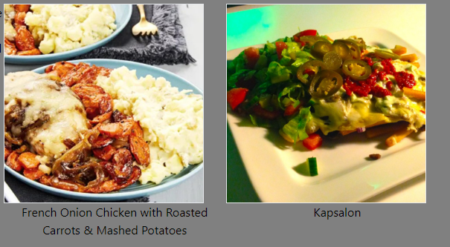

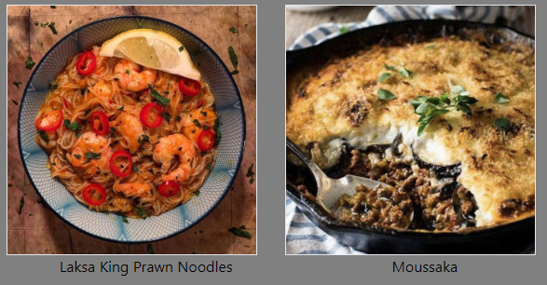
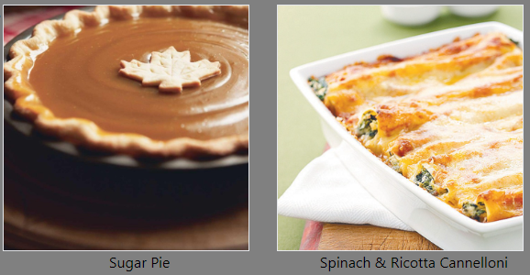
Awais Aslam
Gonzalo García Rivera

Slide 2
WHO WE ARE?
The Food Tracker is a sophisticated food search platform that allows the user to discover new recipes from all over the world to cook.
The meal search process has different criteria:
Through the most popular dishes
Through featured ingredients -> select a meal that uses a specific ingredient.
A randomly selected list of dishes -> constantly updated every time the site is refreshed.
Through every country whose database has at least one meal incorporated.
When you select a meal based in any of these criteria, you will be directed to the recipe section, which contains the required ingredients including a picture and its measures as well as the cooking instructions.

Slide 3
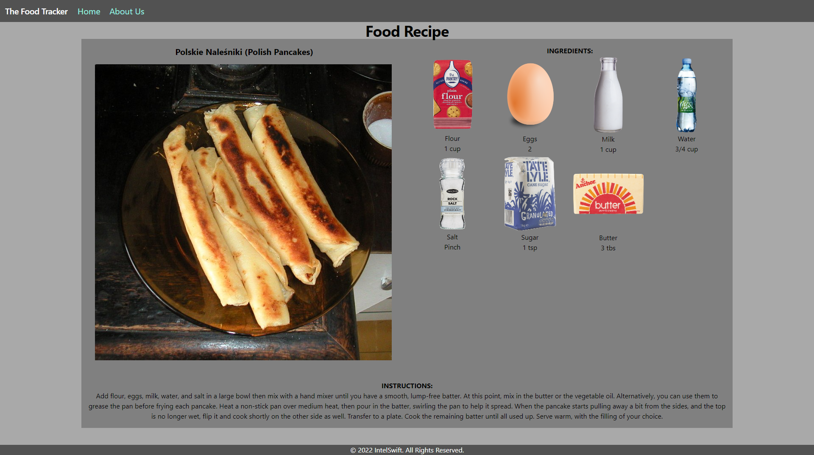
SEARCH FOR YOUR RECIPE
Header & Navigation
Selected dish
List of Ingredients
Cooking instructions
Footer

Slide 4
CONCEPT
Description
The Food Tracker is an online search platform that has multiple criteria selection to access for different types of dishes from all over the world. These criteria selection comes in different fields from ingredients, meals by country, popularity or randomly selected.
Motivation for development?
Develop a platform that will connect people across the world by trying new dishes from unexpected places.
Present and upgrade the platform by incorporating new functions and features in every upcoming version.
User story
AS A food enthusiast
I WANT to see try new dishes from different places based on its ingredients and cooking process.
SO THAT I cook them more frequently

Slide 5
CODING PROCESS
List of employed programs
VS code -> HTML, CSS & JavaScript files
CSS framework -> Tailwind
Web APIs from https://www.themealdb.com/
Breakdown of tasks and roles
Development of the Main page
AA -> Popular Ingredients / Random Meals / Browse Countries Sections
GG -> Popular Meals / Navigation (Home & About Us) / Header / Footer Sections
GG -> About Us Site
AA -> Ingredients & Meals by country sections -> link to Food Recipe Section
AA & GG -> Food Recipe Section
Challenges
Creation of the Js files and sync the functions through the HTML docs to develop the search & result sequence.
Update of each program file as new functions were being incorporated to simplify the process.
Successes
MVP version that contains the basic display segment, search food by different criteria and food recipe segment
Development of Version 1 -> incorporation of a search filter option and updated sync of each section.

Slide 6
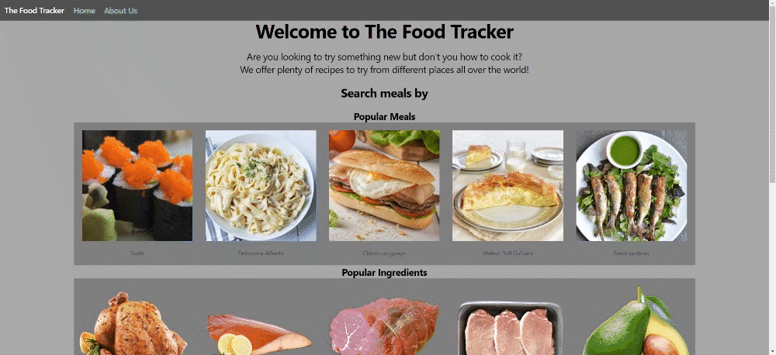
DEMO - MVP – MAIN SITE

Slide 7
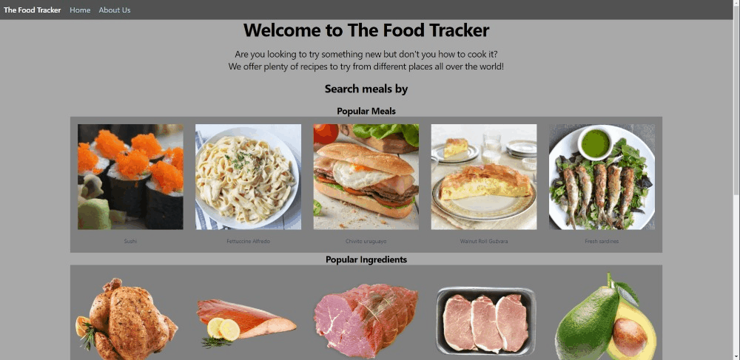
DEMO – NAVIGATION

Slide 8
DEMO – SELECTION - POPULAR

Slide 9
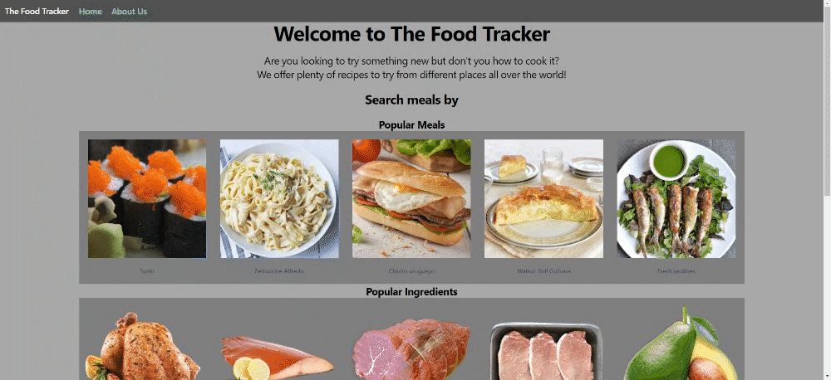
DEMO – SELECTION - INGREDIENT

Slide 10
DEMO – SELECTION - RANDOM

Slide 11
DEMO – SELECTION - COUNTRY

Slide 12
FUTURE VERSIONS -> DIRECTIONS
Version 1 (Achieved) -> Inclusion of a filter search option for meals
Version 2 -> V1 + Inclusion of a search button to a new section of all ingredients
Version 3 -> V2 + adding new countries
Version 4 -> V3 + adding new features like taste property (sweet, salty, bitter, etc.)
Version 5 -> V4 + adding nutritional information of each meal and ingredient
Version 6 -> V5 + partnership with markets for users to shop recipes (ingredients).
Version 7 -> V6 + budget & inflation function: able for users to set up a budget for purchase and review expenses when ingredient prices change.
And so on…

Slide 13
LINKS
Deployed Site ->
GitHub repo -> https://github.com/Ggariv/Project-1

Slide 14
THANK YOU

